Slide 1
ADVANCE NETWORKING
Introduction to Networking
Resource Person: Sanjeewa Bandara Ekanayake, B.Sc., MIT (UCSC)

Slide 2
What is networking
There are many types of networks that provide us with different kinds of services.
a person might make a phone call
watch a television show
listen to the radio
look up something on the Internet
play a video game with someone in another country.

Slide 3
What is networking ...
All of these activities depend on robust, reliable networks.
Networks provide the ability to connect people and equipment no matter where they are in the world.
People use networks without ever thinking about how they work or what it would be like if the networks did not exist.

Slide 4
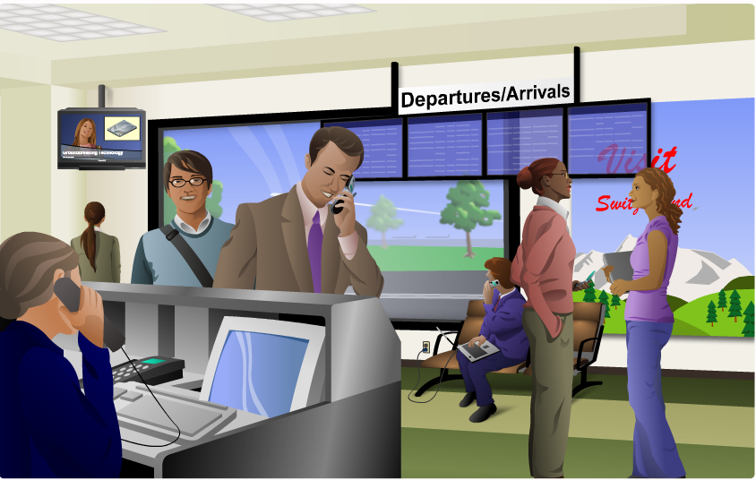
Learn different networks ...

Slide 5
What is networking ...
Communication technology in the 1990s, and before, required separate, dedicated networks for voice, video and computer data communications.
Each of these networks required a different type of device in order to access the network.
Telephones, televisions, and computers used specific technologies and different dedicated network structures, to communicate.

Slide 6
What is networking ...
what if people want to access all of these network services at the same time, possibly using a single device?
New technologies create a new kind of network that delivers more than a single type of service.
these new converged networks are capable of delivering voice, video and data services over the same communication channel or network structure.

Slide 7
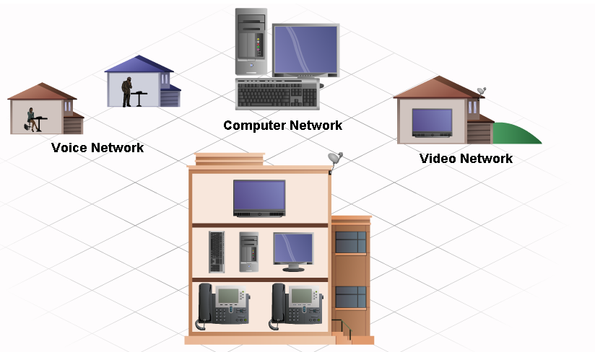
Converged Networks

Slide 8
Benefits of Networks
Networks come in all sizes.
They can range from simple networks consisting of two computers, to networks connecting millions of devices.
Networks enable sharing of resources
In business, large networks can be used to advertise and sell products, order supplies, and communicate with customers.
Communication over a network is usually more efficient and less expensive than traditional forms of communication, such as regular mail or long distance phone calls.

Slide 9
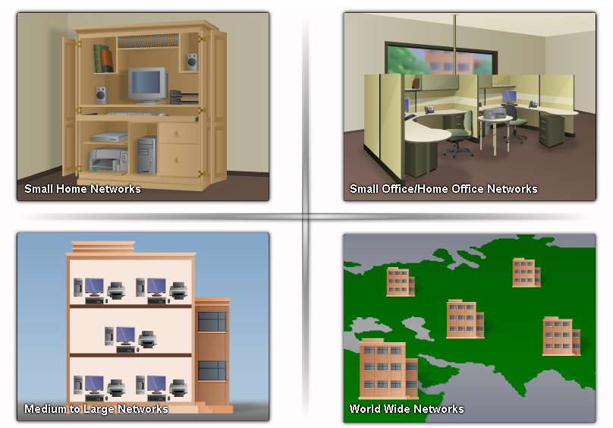
Benefits of networks ...

Slide 10
Here are other uses of a network and the Internet:
Sharing music and video files
Research and on-line learning
Chatting with friends
Planning vacations
Purchasing gifts and supplies

Slide 11
Basic Network Components
There are many components that can be part of a network.
for example: personal computers, servers, networking devices, and cabling.
These components can be grouped into four main categories:
Hosts
Shared peripherals
Networking devices
Networking media

Slide 12
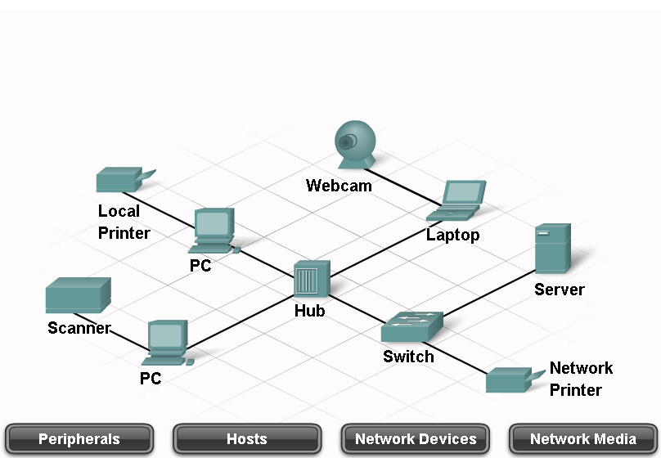
Basic network components

Slide 13
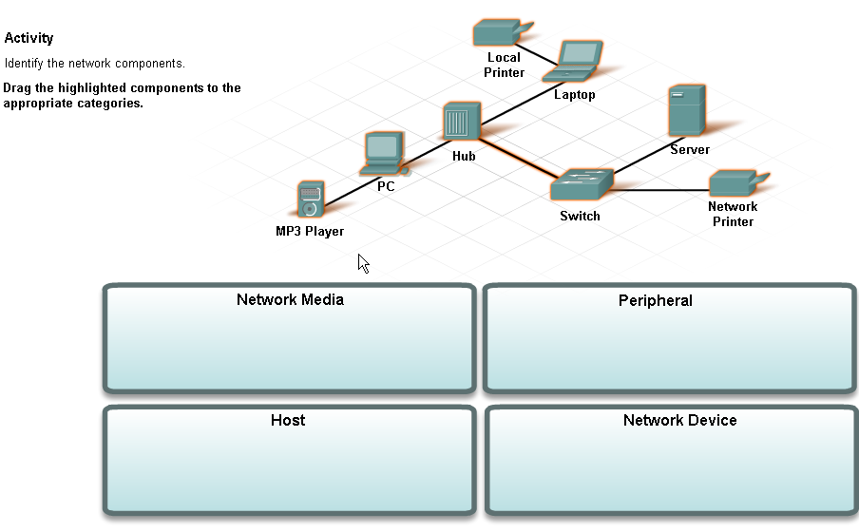
Activity

Slide 14
Computer roles in a Network
All computers connected to a network that participate directly in network communication are classified as hosts.
Hosts can send and receive messages on the network. In modern networks, computer hosts can act as a client, a server, or both.
The software installed on the computer determines which role the computer plays.
Servers are hosts that have software installed that enable them to provide information, like email or web pages, to other hosts on the network.
Each service requires separate server software. For example, a host requires web server software in order to provide web services to the network.
Clients are computer hosts that have software installed that enable them to request and display the information obtained from the server.

Slide 15
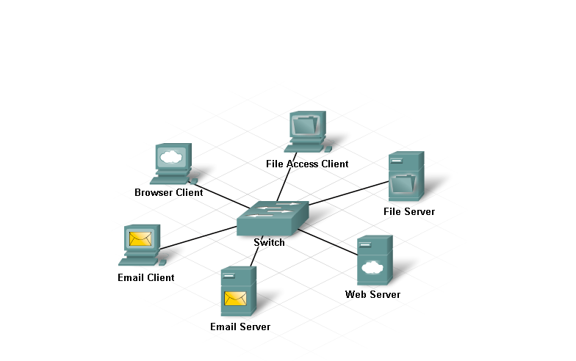
Computer roles in a network

Slide 16
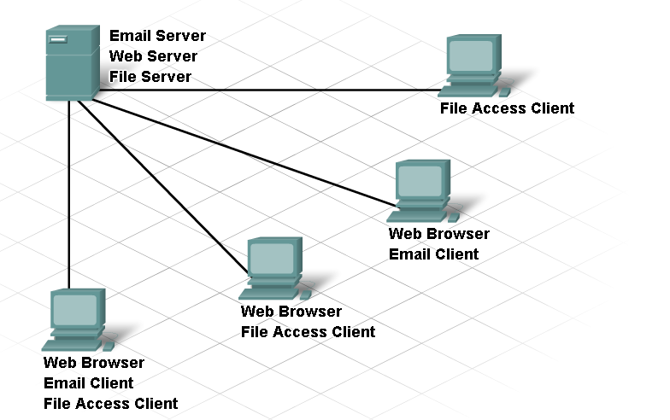
Computer roles in a network

Slide 17
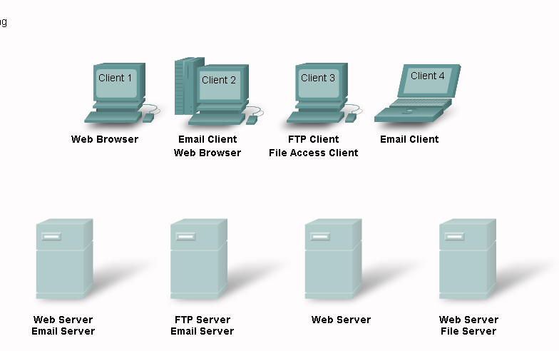
Activity 2

Slide 18
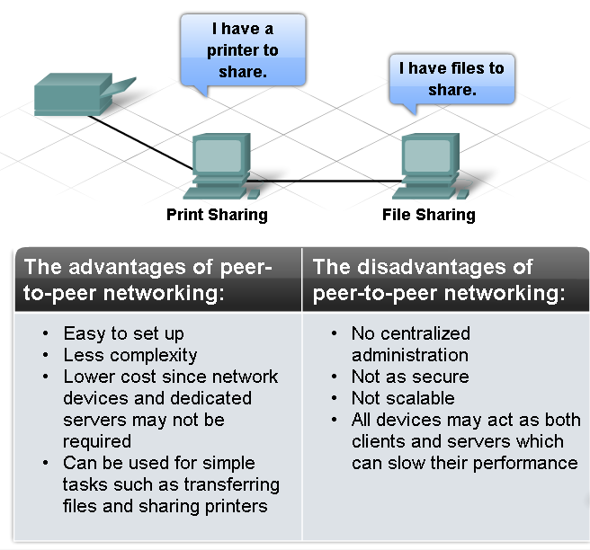

Slide 19
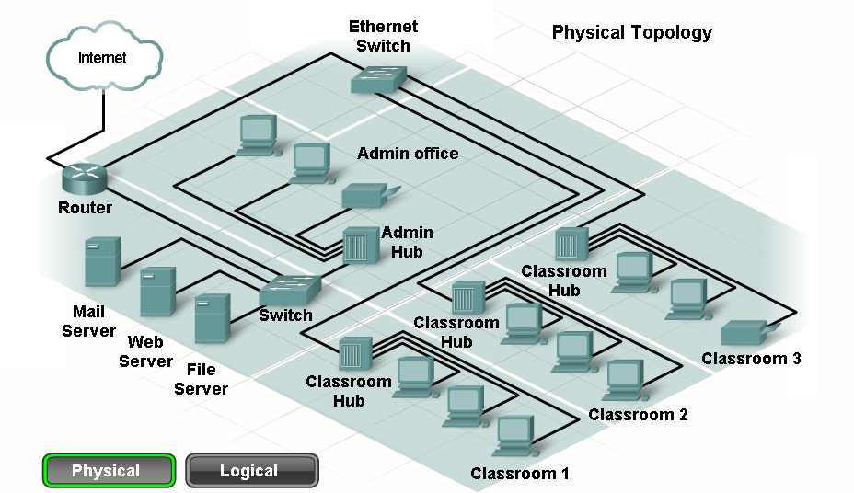
Network topologies

Slide 20
Rules of communication
Identification of sender and receiver
Agreed-upon medium or channel (face-to-face, telephone, letter, photograph)
Appropriate communication mode (spoken, written, illustrated, interactive or one-way)
Common language
Grammar and sentence structure
Speed and timing of delivery

Slide 21
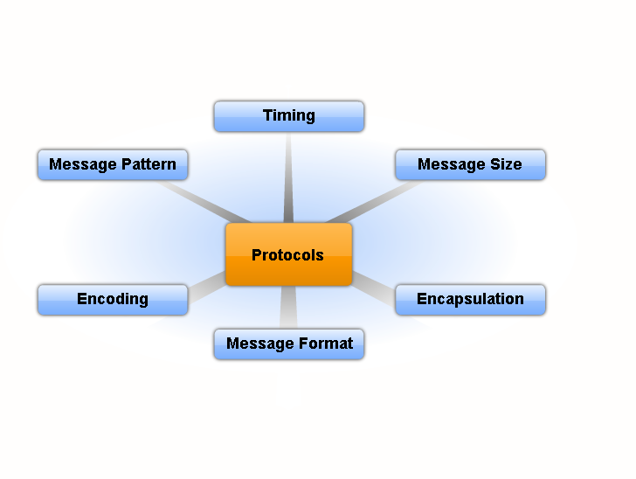
Rules of communication

Slide 22
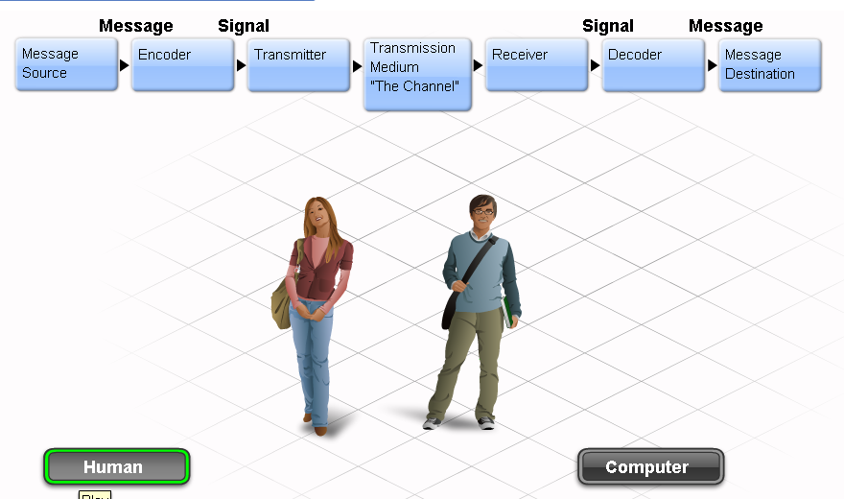
Message Encoding

Slide 23
Communicating local wired network
Computers, just like humans, use rules, or protocols, in order to communicate.
Protocols are especially important on a local network. In a wired environment, a local network is defined as an area where all hosts must "speak the same language" or in computer terms "share a common protocol".

Slide 24
Standard Use to communicate in Local Wired Network
IEEE committees are responsible for approving and maintaining the standards for connections, media requirements and communications protocols.
Each technology standard is assigned a number that refers to the committee that is responsible for approving and maintaining the standard.
The committee responsible for the Ethernet standards is 802.3.

Slide 25
Standard of protocols
In the early days of networking, each vendor used their own, proprietary methods of interconnecting network devices and networking protocols.
Equipment from one vendor could not communicate with equipment from another.
As networks became more widespread, standards were developed that defined rules by which network equipment from different vendors operated.

Slide 26
Standard of protocols …
Standards are beneficial to networking in many ways:
Facilitate design
Simplify product development
Promote competition
Provide consistent interconnections
Facilitate training
Provide more vendor choices for customers
There is no official local networking standard protocol, but over time, one technology, Ethernet, has become more common than the others.

Slide 27
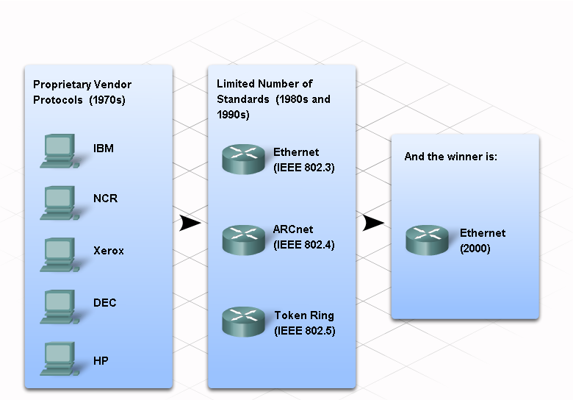
Standard of protocols …

Slide 28
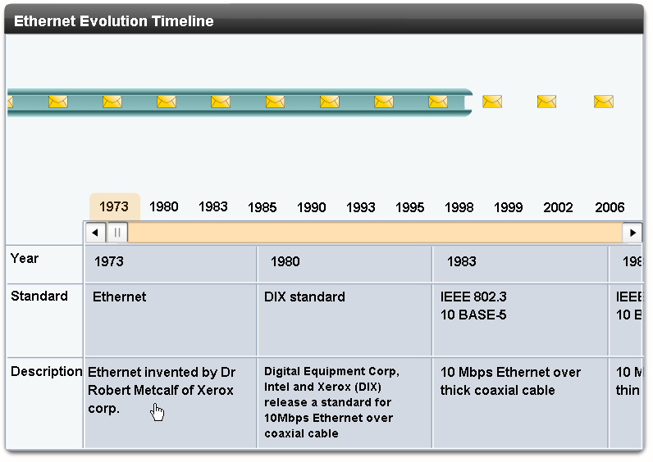
Evolution of Ethernet Timeline

Slide 29
Since the creation of Ethernet in 1973, standards have evolved for specifying faster and more flexible versions of the technology.
This ability for Ethernet to improve over time is one of the main reasons that it has become so popular.
Each version of Ethernet has an associated standard. For example, 802.3 100BASE-T represents the 100 Megabit Ethernet using twisted pair cable standards. The standard notation translates as:
100 is the speed in Mbps
BASE stands for baseband transmission
T stands for the type of cable, in this case, twisted pair.

Slide 30
Physical Addressing
All communication requires a way to identify the source and destination
The source and destination in human communication are represented by names.
When a name is called, the person with that name listens to the message and responds.
Other people in the room may hear the message, but they ignore it because it is not addressed to them.
On Ethernet networks, a similar method exists for identifying source and destination hosts.
On Ethernet networks, a similar method exists for identifying source and destination hosts.

Slide 31
Physical Addressing ...
Every Ethernet network interface has a physical address assigned to it when it is manufactured.
The MAC address identifies each source and destination host on the network.
Ethernet networks are cable based, meaning that a copper or fiber optic cable connects hosts and networking devices.
This is the channel used for communications between the hosts.
When a host on an Ethernet network communicates, it sends frames containing its own MAC address as the source and the MAC address of the intended recipient.

Slide 32
Physical Addressing ...
Any hosts that receive the frame will decode the frame and read the destination MAC address.
If the destination MAC address matches the address configured on the NIC, it will process the message and store it for the host application to use.
If the destination MAC address does not match the host MAC address, the NIC will ignore the message.

Slide 33
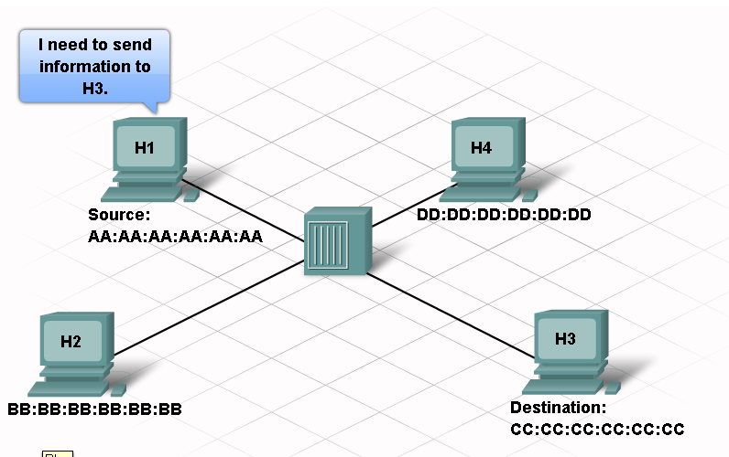
Physical Addressing ...

Slide 34
Determine the MAC Address of a Host
Determine the MAC address of a Windows XP computer on an Ethernet network using the ipconfig /all command.
Access to the Run command.
Every computer on an Ethernet local network has a Media Access Control (MAC) address that is burned into the Network Interface Card(NIC).
Computer MAC addresses are usually displayed as 6 sets of two hexadecimal numbers separated by dashes or colons. (example: 15-EF-A3-45-9B-57).
The ipconfig /all command displays the computer MAC address. You may work individually or in teams.

Slide 35
Ethernet Communication
The Ethernet protocol standards define many aspects of network communication including frame format, frame size, timing and encoding.
When messages are sent between hosts on an Ethernet network, the hosts format the messages into the frame layout that is specified by the standards.
Frames are also referred to as Protocol Data Units (PDUs).

Slide 36
Ethernet Communication...
The format for Ethernet frames specifies the location of the destination and source MAC addresses, and additional information including:
Preamble for sequencing and timing
Start of frame delimiter
Length and type of frame
Frame check sequence to detect transmission errors.

Slide 37
Ethernet Communication...
The size of Ethernet frames is limited to a maximum of 1518 bytes and a minimum size of 64 bytes.
Frames that do not match these limits are not processed by the receiving hosts. In addition to the frame formats, sizes and timing, Ethernet standards define how the bits making up the frames are encoded onto the channel.

Slide 38
Ethernet Communication...
Bits are transmitted as either electrical impulses over copper cable or as light impulses over fiber optic cable.

Slide 39
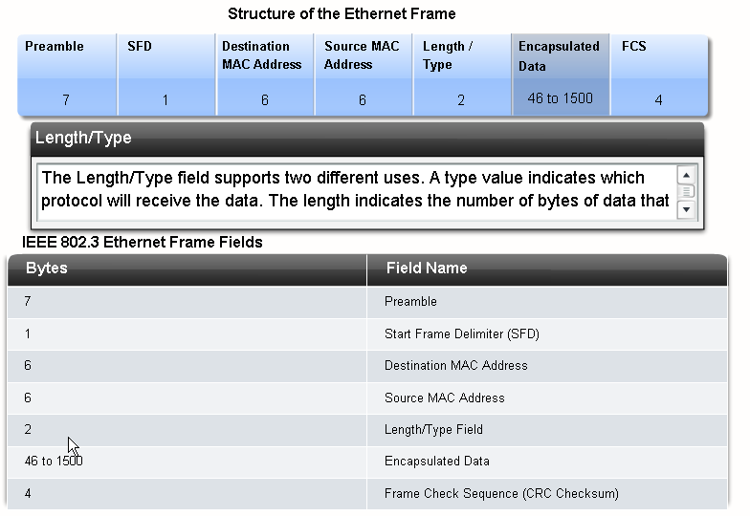

Slide 40
Hierarchical design of Ethernet Network
In networking, hierarchical design is used to group devices into multiple networks that are organized in a layered approach.
It consists of smaller, more manageable groups that allow local traffic to remain local. Only traffic that is destined for other networks is moved to a higher layer.

Slide 41
Hierarchical design of Ethernet Network
A hierarchical, layered design provides increased efficiency, optimization of function, and increased speed.
It allows the network to scale as required because additional local networks can be added without impacting the performance of the existing ones.

Slide 42
Hierarchical design of Ethernet Network
The hierarchical design has three basic layers:
Access Layer - to provide connections to hosts in a local Ethernet network.
Distribution Layer - to interconnect the smaller local networks.
Core Layer - a high-speed connection between distribution layer devices.
Access Layer - to provide connections to hosts in a local Ethernet network.
Distribution Layer - to interconnect the smaller local networks.
Core Layer - a high-speed connection between distribution layer devices.

Slide 43
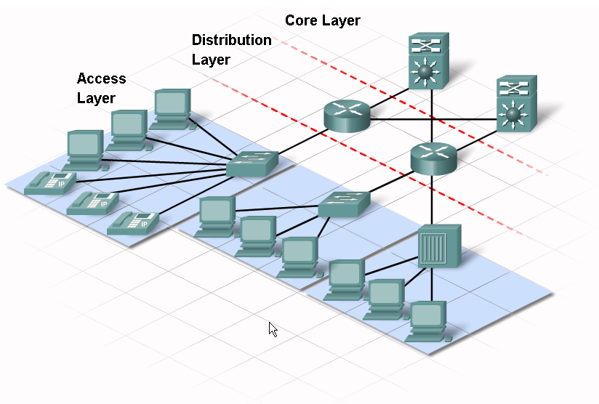

Slide 44
Logical Addressing
The IP address is similar to the address of a person. It is known as a logical address because it is assigned logically based on where the host is located.
The IP address, or network address, is assigned to each host by a network administrator based on the local network.
IP addresses contain two parts. One part identifies the local network.
The network portion of the IP address will be the same for all hosts connected to the same local network.
The second part of the IP address identifies the individual host. Within the same local network, the host portion of the IP address is unique to each host.

Slide 45
Logical Addressing
Both the physical MAC and logical IP addresses are required for a computer to communicate on a hierarchical network, just like both the name and address of a person are required to send a letter.

Slide 46
Function of Hub
A hub is one type of networking device that is installed at the Access Layer of an Ethernet network. Hubs contain multiple ports that are used to connect hosts to the network.
Hubs are simple devices that do not have the necessary electronics to decode the messages sent between hosts on the network.
Hubs cannot determine which host should get any particular message. A hub simply accepts electronic signals from one port and regenerates (or repeats) the same message out all of the other ports.
Remember that the NIC on a host accepts messages only addressed to the correct MAC address. Hosts ignore messages that are not addressed to them. Only the host specified in the destination address of the message processes the message and responds to the sender.
All of the ports on the Ethernet hub connect to the same channel to send and receive messages. Because all hosts must share the bandwidth available on that channel, a hub is referred to as a shared-bandwidth device.

